Slide 1
CMSC 207
Discrete Structures
Jan 8, 2004
© Vadim Bulitko - CMPUT 272, Winter 2004, UofA

Slide 2
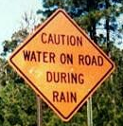

Today
Refresher: Chapter 1.1
Chapter 1.2
Chapter 1.3 ?
All images are copyrighted to their respective copyright holders and reproduced here for academic purposes under the “condition of fair using”.
Jan 8, 2004
© Vadim Bulitko - CMPUT 272, Winter 2004, UofA

Slide 3
Logic
Mathematical logic is a tool for dealing with formal reasoning
In a nutshell:
Logic does:
  Assess if an argument is valid/invalid
Logic does not directly:
  Assess the truth of atomic statements
Jan 8, 2004
© Vadim Bulitko - CMPUT 272, Winter 2004, UofA

Slide 4
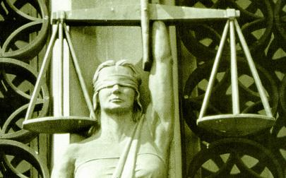

Differences
Logic can deduce that:
  Edmonton is in Canada
given these facts:
  Edmonton is in Alberta
  Alberta is a part of Canada
and the definitions of:
  ‘to be a part of’
  ‘to be in’
Logic knows nothing of whether these facts actually hold in real life!
Jan 8, 2004
© Vadim Bulitko - CMPUT 272, Winter 2004, UofA

Slide 5

Questions?
Jan 8, 2004
© Vadim Bulitko - CMPUT 272, Winter 2004, UofA

Slide 6
Connectives
Different notation is in use
We will use the common math notation:
  ~ not
  V or (non-exclusive!)
  & and
  → implies (if … then …)
  ⬄ if and only if
  ∀ for all
  ∃ exists
See the reverse of the text’s front cover
Jan 8, 2004
© Vadim Bulitko - CMPUT 272, Winter 2004, UofA

Slide 7
Formulae
A statement/proposition: true or false
Atomic: P, Q, X, Y, …
Unit Formula: P, ~P, (formula), …
Conjunctive: P & Q, P & ~Q, …
Disjunctive: P v Q, P v (P & X),…
Conditional: P → Q
Biconditional: P ⬄ Q
Jan 8, 2004
© Vadim Bulitko - CMPUT 272, Winter 2004, UofA

Slide 8
Precedence
~ highest
&
v
→, ⬄ lowest
Avoid confusion - use ‘(‘ and ‘)’:
  P & Q v X
  (P & Q) v X
Jan 8, 2004
© Vadim Bulitko - CMPUT 272, Winter 2004, UofA

Slide 9
Determining Truth of A Formula
Atomic formulae: given
Compound formulae: via meaning of
the connectives
Suppose: P is true
Q is false
How about: (P v Q)
Truth tables
Jan 8, 2004
© Vadim Bulitko - CMPUT 272, Winter 2004, UofA

Slide 10

Conditionals
“If I go to Save-on-Foods tomorrow I will buy oranges there”
S = (go to SOF) → (buy oranges)
When is S true?
  When I went to SOF and bought oranges
  When I didn’t go there at all!
When is S false?
  When I went there but didn’t buy oranges
Jan 8, 2004
© Vadim Bulitko - CMPUT 272, Winter 2004, UofA

Slide 11
Truth Table
N independent atomic formulae (variables) → 2^{N} rows
N=20: 2²⁰ ~ 1 million
Consider A → B:
  A B A → B
  F F T
  F T T
  T F F
  T T T
Jan 8, 2004
© Vadim Bulitko - CMPUT 272, Winter 2004, UofA

Slide 12
More terminology
A → B
A is called:
  Assumption
  Premise
  Antecedent
B is called
  Conclusion
Jan 8, 2004
© Vadim Bulitko - CMPUT 272, Winter 2004, UofA

Slide 13
Bi-Conditionals
“Marion will take 272 if and only if Norma does so”
S = (Marion takes 272) ⬄ (Norma takes 272)
When is S true?
  When Marion takes is and Norma takes it
  When Marion doesn’t take it and neither does Norma
When is S false?
  When one of them takes it but not the other
Jan 8, 2004
© Vadim Bulitko - CMPUT 272, Winter 2004, UofA

Slide 14
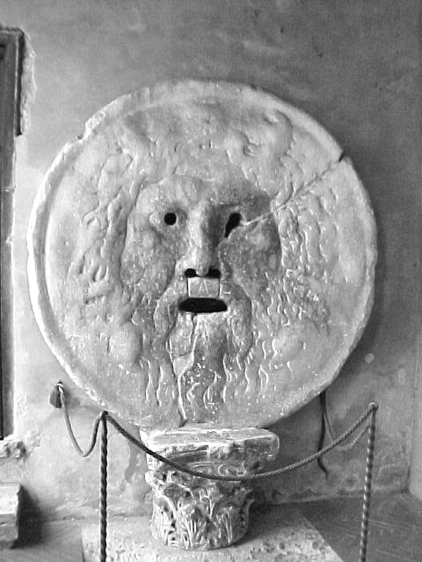
Truth Tables
A B A ⬄ B
F F T
F T F
T F F
T T T
Jan 8, 2004
© Vadim Bulitko - CMPUT 272, Winter 2004, UofA

Slide 15
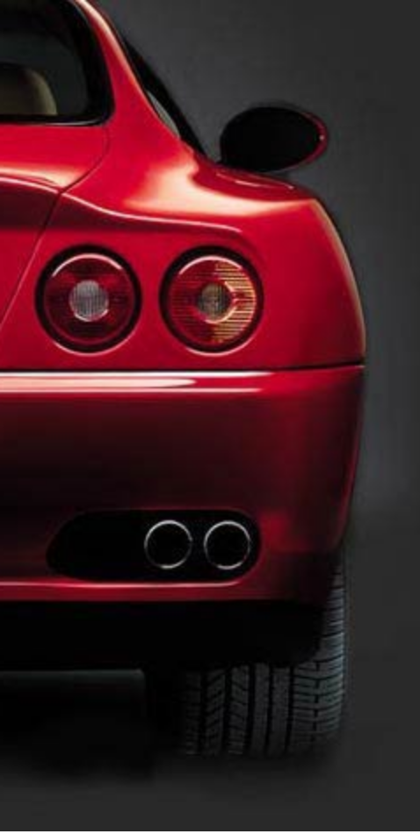
→, ⬄ and Daily Life
Suppose:
  “Buy Ferrari” = B
  “Ferrari is on sale” = S
I will buy a Ferrari if it is on sale:
  S → B
I will buy a Ferrari if and only if it is on sale:
  S ⬄ B
I will buy a Ferrari only if it is on sale:
  ~S → ~B
  B → S
Jan 8, 2004
© Vadim Bulitko - CMPUT 272, Winter 2004, UofA

Slide 16
Sufficient & Necessary Conditions
Suppose the Ferrari salesperson wants to figure out when you are ready to buy one of their cars…
  B = “ready to buy”
  X = some condition of you
If they find X such that: X → B
  Then they have a sufficient condition
  Example: X = “got a UofA scholarship”
If they find X such that: B → X
  Then they have a necessary condition
  Example: X = “it is winterized”
Jan 8, 2004
© Vadim Bulitko - CMPUT 272, Winter 2004, UofA

Slide 17

Criteria
If they find X such that: B ⬄ X
  Then they have a criterion
What would be an example?
How about a conjunction of the sufficient and necessary conditions?
  X = “got UofA scholarship and it is winterized”
Doesn’t work: you may get a Ferrari Christmas gift certificate from your grandma and you will just go and pick one up (regardless of whether you got the scholarship)
Jan 8, 2004
© Vadim Bulitko - CMPUT 272, Winter 2004, UofA

Slide 18
Summary
Suppose X is a statement
A is a sufficient condition for X iff we can prove that:
“A implies X”
A is necessary condition for X iff we can prove that:
“X implies A”
A is a criterion for X iff we can prove that:
“X holds if and only if A holds”
Jan 8, 2004
© Vadim Bulitko - CMPUT 272, Winter 2004, UofA

Slide 19
Contradictions & Tautologies
Contradiction:
  A statement that is always false regardless of the values of its variables
Examples: A & ~A
Tautology:
  A statement that is always true regardless of the values of its variables
Examples: A v ~A
Jan 8, 2004
© Vadim Bulitko - CMPUT 272, Winter 2004, UofA

Slide 20
Contingencies
What is I have a formula that is sometimes true and sometimes false?
It is called a contingency
Example:
  A & B
If A and B are independent variables
Jan 8, 2004
© Vadim Bulitko - CMPUT 272, Winter 2004, UofA

Slide 21
Interpretation
In propositional logic interpretation is a mapping from symbols in your formulae to {true, false}
Example:
  Formula: A v B
  Interpretation: A = true, B = false
Jan 8, 2004
© Vadim Bulitko - CMPUT 272, Winter 2004, UofA

Slide 22
Formula Classification
Tautology :
  all interpretations satisfy the formula
Contradiction :
  all interpretations falsify the formula
Contingency :
  some interpretations satisfy and some falsify the formula
Jan 8, 2004
© Vadim Bulitko - CMPUT 272, Winter 2004, UofA

Slide 23
Models / Counter-models
An interpretation is called a model for formula F iff:
  It satisfies F (i.e., makes F=true)
An interpretation is called a counter-model for formula F iff:
  It falsifies F (i.e., makes F=false)
Jan 8, 2004
© Vadim Bulitko - CMPUT 272, Winter 2004, UofA

Slide 24
Logic Equivalence
Propositions/statements/formulae A and B are logically equivalent when:
  A holds if and only if B holds
Notation: A ≡ B
Examples:
  A v A is equivalent to:
  A
  A v ~A is equivalent to:
  true
Jan 8, 2004
© Vadim Bulitko - CMPUT 272, Winter 2004, UofA

Slide 25
Equivalence & Tautology
Suppose A and B are logically equivalent
Consider proposition (A ⬄ B)
What can we say about it?
It is a tautology!
Why?
A B A ⬄ B
F F T
T T T
Jan 8, 2004
© Vadim Bulitko - CMPUT 272, Winter 2004, UofA

Slide 26
More Equivalences
Alex is not unemployed
  Alex is employed
P ≡ ~(~P) : Double-negation
It is not true that she is single and she is cute
  She is not single or she is not cute
~(A & B) ≡ ~A v ~B : De Morgan’s law
It is not true that she is single or she is cute
  She is not single and she is not cute
~(A v B) ≡ ~A & ~B : De Morgan’s law
Jan 8, 2004
© Vadim Bulitko - CMPUT 272, Winter 2004, UofA

Slide 27
Boolean Algebra
Page 374 presents Theorem 6.4.1 with 21 equivalences
However, only the first 10 are needed
The rest can be derived from them
Example: let’s prove that P v P ≡ P
  P v C ≡ P (4)
  P v (P & ~P) ≡ P (5)
  (P v P) & (P v ~P) ≡ P (3)
  (P v P) & T ≡ P (5)
  P v P ≡ P (4)
Jan 8, 2004
© Vadim Bulitko - CMPUT 272, Winter 2004, UofA

Slide 28

Challenge
Derive the rest (e.g., #8) from the first 5 equivalences…
Jan 8, 2004
© Vadim Bulitko - CMPUT 272, Winter 2004, UofA

Slide 29
Proving Equivalences
Suppose P and Q can take on T and F only
Then all equivalences can be proven by definition using truth tables
P Q ~(P v Q) ~P & ~Q
F F T F T T T
F T F T T F F
T F F T F F T
T T F T F F F
Jan 8, 2004
© Vadim Bulitko - CMPUT 272, Winter 2004, UofA

Slide 30
Another Example
Prove P → Q ≡ ~P v Q
Truth tables…
Jan 8, 2004
© Vadim Bulitko - CMPUT 272, Winter 2004, UofA

Slide 31
Questions?
Jan 8, 2004
© Vadim Bulitko - CMPUT 272, Winter 2004, UofA

Slide 32
Uses of Equivalences
Simplification
Suppose someone gives you
  ~P v (A→B) v ~(C v D → H) v P v X⬄Y
and asks you to compute it for all possible input values
You can either immediately draw a truth table with 2⁸ = 256 rows
Or you can simplify it first
Jan 8, 2004
© Vadim Bulitko - CMPUT 272, Winter 2004, UofA

Slide 33
Simplification
~P v (A→B) v ~(C v D → H) v P v X⬄Y
~P v P v (A→B) v ~(C v D → H) v X⬄Y
T v (A→B) v ~(C v D → H) v X⬄Y
T
The statement is a tautology – always true…
Jan 8, 2004
© Vadim Bulitko - CMPUT 272, Winter 2004, UofA

Slide 34
Test Drive
Let’s take our equivalence tool box for a spin…
What can we tell about
  A → B
and its contraposition:
  ~B → ~A
?
They are equivalent !
Jan 8, 2004
© Vadim Bulitko - CMPUT 272, Winter 2004, UofA

Slide 35
Proof?
Truth-tables
Equivalences
  A → B
  ~A v B
  B v ~A
  ~B → ~A
Isn’t this fun?
Jan 8, 2004
© Vadim Bulitko - CMPUT 272, Winter 2004, UofA

Slide 36
Test Drive
Let’s try another one!
What can we tell about
  A → B
and its inverse:
  ~A → ~B
?
Oh-oh…
They are not equivalent!
Counter-model: A is false and B is true…
Jan 8, 2004
© Vadim Bulitko - CMPUT 272, Winter 2004, UofA

Slide 37
Summary
Implication
  A → B
is equivalent to:
  ~B → ~A : its contraposition
But is not equivalent to:
  ~A → ~B : its inverse
Or to:
  B → A : its converse
Jan 8, 2004
© Vadim Bulitko - CMPUT 272, Winter 2004, UofA

Slide 38
Another Lesson Learned
Proving equivalences
  via truth-tables
  via other equivalences
Proving non-equivalence:
  Finding an instantiation that makes one formula hold and the other doesn’t
Jan 8, 2004
© Vadim Bulitko - CMPUT 272, Winter 2004, UofA

Slide 39
Bi-conditionals
How can we express:
  A ⬄ B
With &, v, ~ ?
It is simply:
  (A & B) v (~A & ~B)
How can we express it with →, & ?
Why, but of course it is just:
  (A → B) & (B → A)
Jan 8, 2004
© Vadim Bulitko - CMPUT 272, Winter 2004, UofA

Slide 40
Another Spin…
Ok, let’s try this fun ride:
  (P → Q) & P
In English it would sound:
  (If P is true then Q is true) and (P is true)
What does it tell us?
  Naturally Q is true!
Let’s prove it…
Jan 8, 2004
© Vadim Bulitko - CMPUT 272, Winter 2004, UofA

Slide 41
Proving…
(P → Q) & P
(~P v Q) & P
~P & P v Q & P
F v Q & P
Q & P
But we want just Q not Q & P!
Is Q & P ≡ Q ?
No -- counter-model: Q=T and P=F …
Jan 8, 2004
© Vadim Bulitko - CMPUT 272, Winter 2004, UofA

Slide 42
What is the matter?
Not all arguments have the form of a chain of equivalences
Example:
  P→Q = “If Socrates is human then Socrates is mortal”
  P=“Socrates is human”
  A conjunction of these two is NOT equivalent to Q = “Socrates is mortal”
  Why?
  Name a dog Socrates. It is mortal (Q holds). But it is NOT human (P does not hold)…
Jan 8, 2004
© Vadim Bulitko - CMPUT 272, Winter 2004, UofA

Slide 43
Entailment
A collection of statements P₁,…,P_{n} (premises) entails statement Q (conclusion) if and only if:
Whenever all premises hold the conclusion holds
Example:
  Premises:
    P₁ = “If Socrates is human then Socrates is mortal”
    P₂ = “Socrates is human”
  Conclusion:
    Q = “Socrates is mortal”
Jan 8, 2004
© Vadim Bulitko - CMPUT 272, Winter 2004, UofA

Slide 44
Valid/Invalid Arguments
Suppose someone makes an argument:
  P₁,..,P_{N} therefore Q
The argument is called valid iff:
  P₁,…,P_{N} logically entail Q
That is:
  Q must hold when all P_{i} hold
Otherwise the argument is called invalid
Jan 8, 2004
© Vadim Bulitko - CMPUT 272, Winter 2004, UofA

Slide 45
Relation to Tautologies
We already know that formulae A and B are equivalent iff (A ⬄ B) is a tautology (i.e., holds for any interpretation)
How about entailment?
Formula A entails formula B iff (A → B) is a tautology
In general: premises P₁,…,P_{N} entail Q iff (P₁ & … & P_{N} → Q) is a tautology
Jan 8, 2004
© Vadim Bulitko - CMPUT 272, Winter 2004, UofA

Slide 46
Questions?
Jan 8, 2004
© Vadim Bulitko - CMPUT 272, Winter 2004, UofA

